Slide 1


Dictionary in Python

Slide 2

Why do we need Dictionary? (Why)
You can use a dictionary to look up the meaning of any words that you don’t understand.
A good dictionary can help you understand your subject better, improve your communication and improve your grades by making sure you are using words correctly.

Slide 3
Why do we need Dictionary in Python?
Dictionary in Python is an unordered collection of data values, used to store data values like a map, which, unlike other Data Types that hold only a single value as an element, Dictionary holds key:value pair. Key-value is provided in the dictionary to make it more optimized.
Notes:
Programming sekhny ka maksad hia k ham apni real life problem computer ki madad sy solve ker sakhain.
Ham apni roz mara zindagi main bhot sary decision conditions ki base per lyty hain jesy k
Agr kal barish hoi to ham pick nick per jain gy
Agr aaj school ki chuti hoi to main cartoon daikoun ga
Or Agr kal mjy job mill gi to main aap ko party doun ga.
In conditions ko programming main handel kerny k leay conditional structure use hoty hain.

Slide 4
What is a Dictionary in Python?
A dictionary is a collection which is ordered (As of Python version 3.7, dictionaries are ordered. In Python 3.6 and earlier, dictionaries are unordered), changeable and does not allow duplicates
Dictionaries are used to store data values in key:value pairs.
Notes:
Programming sekhny ka maksad hia k ham apni real life problem computer ki madad sy solve ker sakhain.
Ham apni roz mara zindagi main bhot sary decision conditions ki base per lyty hain jesy k
Agr kal barish hoi to ham pick nick per jain gy
Agr aaj school ki chuti hoi to main cartoon daikoun ga
Or Agr kal mjy job mill gi to main aap ko party doun ga.
In conditions ko programming main handel kerny k leay conditional structure use hoty hain.

Slide 5
Creating a Dictionary in Python?
A Dictionary can be created by placing a sequence of elements within curly {} braces, separated by ‘comma’.
Dictionary holds a pair of values, one being the Key and the other corresponding pair element being its Key:value.
Values in a dictionary can be of any data type and can be duplicated, whereas keys can’t be repeated and must be immutable.
Notes:
Programming sekhny ka maksad hia k ham apni real life problem computer ki madad sy solve ker sakhain.
Ham apni roz mara zindagi main bhot sary decision conditions ki base per lyty hain jesy k
Agr kal barish hoi to ham pick nick per jain gy
Agr aaj school ki chuti hoi to main cartoon daikoun ga
Or Agr kal mjy job mill gi to main aap ko party doun ga.
In conditions ko programming main handel kerny k leay conditional structure use hoty hain.

Slide 6
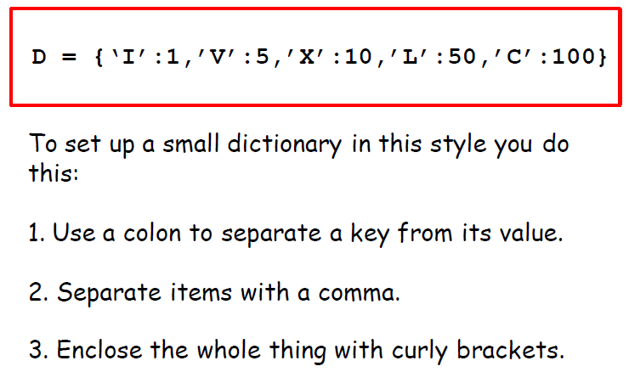
Creating a dictionary in Python?
Creating an empty dictionary:
Dict = {}
print("Empty Dictionary: ")
print(Dict)
Output: Empty Dictionary: {}
Notes:
Programming sekhny ka maksad hia k ham apni real life problem computer ki madad sy solve ker sakhain.
Ham apni roz mara zindagi main bhot sary decision conditions ki base per lyty hain jesy k
Agr kal barish hoi to ham pick nick per jain gy
Agr aaj school ki chuti hoi to main cartoon daikoun ga
Or Agr kal mjy job mill gi to main aap ko party doun ga.
In conditions ko programming main handel kerny k leay conditional structure use hoty hain.

Slide 7
Creating a dictionary in Python?
Creating an empty dictionary:
Dict = {}
print("Empty Dictionary: ")
print(Dict)
Output: Empty Dictionary: {}
Notes:
Programming sekhny ka maksad hia k ham apni real life problem computer ki madad sy solve ker sakhain.
Ham apni roz mara zindagi main bhot sary decision conditions ki base per lyty hain jesy k
Agr kal barish hoi to ham pick nick per jain gy
Agr aaj school ki chuti hoi to main cartoon daikoun ga
Or Agr kal mjy job mill gi to main aap ko party doun ga.
In conditions ko programming main handel kerny k leay conditional structure use hoty hain.

Slide 8
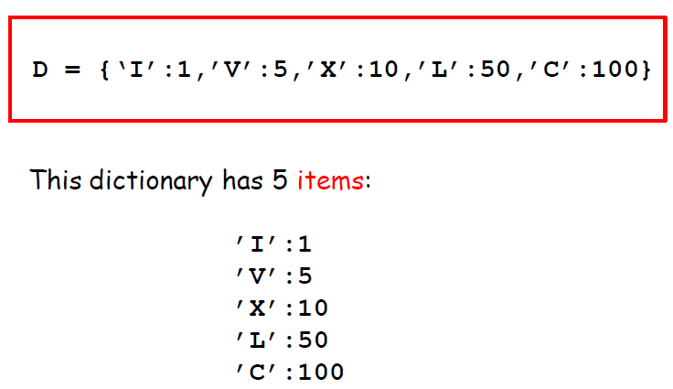
Creating a dictionary in Python?
Creating an empty dictionary:
Dict = {}
print("Empty Dictionary: ")
print(Dict)
Output: Empty Dictionary: {}
Notes:
Programming sekhny ka maksad hia k ham apni real life problem computer ki madad sy solve ker sakhain.
Ham apni roz mara zindagi main bhot sary decision conditions ki base per lyty hain jesy k
Agr kal barish hoi to ham pick nick per jain gy
Agr aaj school ki chuti hoi to main cartoon daikoun ga
Or Agr kal mjy job mill gi to main aap ko party doun ga.
In conditions ko programming main handel kerny k leay conditional structure use hoty hain.

Slide 9
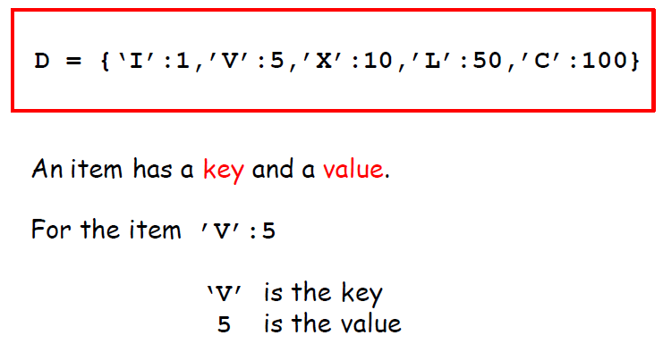
Creating a dictionary in Python?
Creating an empty dictionary:
Dict = {}
print("Empty Dictionary: ")
print(Dict)
Output: Empty Dictionary: {}
Notes:
Programming sekhny ka maksad hia k ham apni real life problem computer ki madad sy solve ker sakhain.
Ham apni roz mara zindagi main bhot sary decision conditions ki base per lyty hain jesy k
Agr kal barish hoi to ham pick nick per jain gy
Agr aaj school ki chuti hoi to main cartoon daikoun ga
Or Agr kal mjy job mill gi to main aap ko party doun ga.
In conditions ko programming main handel kerny k leay conditional structure use hoty hain.

Slide 10
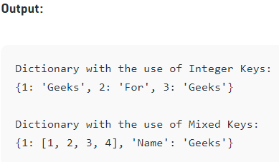
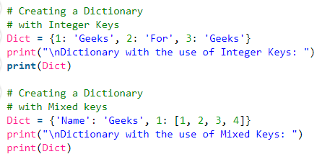
Creating a dictionary in Python?
Notes:
Programming sekhny ka maksad hia k ham apni real life problem computer ki madad sy solve ker sakhain.
Ham apni roz mara zindagi main bhot sary decision conditions ki base per lyty hain jesy k
Agr kal barish hoi to ham pick nick per jain gy
Agr aaj school ki chuti hoi to main cartoon daikoun ga
Or Agr kal mjy job mill gi to main aap ko party doun ga.
In conditions ko programming main handel kerny k leay conditional structure use hoty hain.

Slide 11
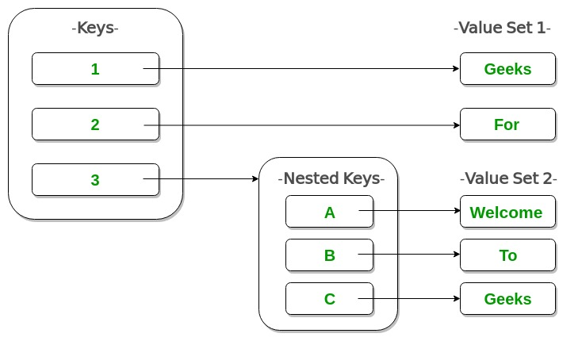
Nested dictionary?
Creg an empty dictionary:
Dict = {}
print("Empty Dictionary: ")
print(Dict)
Output: Empty Dictionary: {}
Notes:
Programming sekhny ka maksad hia k ham apni real life problem computer ki madad sy solve ker sakhain.
Ham apni roz mara zindagi main bhot sary decision conditions ki base per lyty hain jesy k
Agr kal barish hoi to ham pick nick per jain gy
Agr aaj school ki chuti hoi to main cartoon daikoun ga
Or Agr kal mjy job mill gi to main aap ko party doun ga.
In conditions ko programming main handel kerny k leay conditional structure use hoty hain.

Slide 12
Create a nested dictionary in python?
Create a nested dictionary:
Dict = {1: 'Geeks', 2: 'For',
3:{'A' : 'Welcome', 'B' : 'To'}}
print(Dict)
Output: {{1: 'Geeks', 2: 'For', 3: {'A': 'Welcome', 'B': 'To'}}
Notes:
Programming sekhny ka maksad hia k ham apni real life problem computer ki madad sy solve ker sakhain.
Ham apni roz mara zindagi main bhot sary decision conditions ki base per lyty hain jesy k
Agr kal barish hoi to ham pick nick per jain gy
Agr aaj school ki chuti hoi to main cartoon daikoun ga
Or Agr kal mjy job mill gi to main aap ko party doun ga.
In conditions ko programming main handel kerny k leay conditional structure use hoty hain.

Slide 13
Accessing a dictionary element?
You can access the items of a dictionary by referring to its key name, inside square brackets:
thisdict = {"brand": "Ford", "model": "Mustang", "year": 1964}
x = thisdict["model"]
Output: Mustang
Notes:
Programming sekhny ka maksad hia k ham apni real life problem computer ki madad sy solve ker sakhain.
Ham apni roz mara zindagi main bhot sary decision conditions ki base per lyty hain jesy k
Agr kal barish hoi to ham pick nick per jain gy
Agr aaj school ki chuti hoi to main cartoon daikoun ga
Or Agr kal mjy job mill gi to main aap ko party doun ga.
In conditions ko programming main handel kerny k leay conditional structure use hoty hain.

Slide 14
Accessing a dictionary element?
There is also a method called get() that will give you the same result
thisdict = {"brand": "Ford", "model": "Mustang", "year": 1964}
x = thisdict.get("model“)
Output: Mustang
Notes:
Programming sekhny ka maksad hia k ham apni real life problem computer ki madad sy solve ker sakhain.
Ham apni roz mara zindagi main bhot sary decision conditions ki base per lyty hain jesy k
Agr kal barish hoi to ham pick nick per jain gy
Agr aaj school ki chuti hoi to main cartoon daikoun ga
Or Agr kal mjy job mill gi to main aap ko party doun ga.
In conditions ko programming main handel kerny k leay conditional structure use hoty hain.

Slide 15
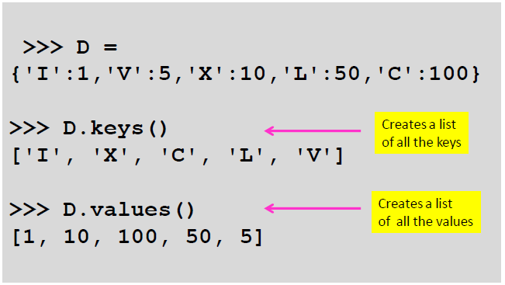
Methods .keys and .values in dictionary?
Notes:
Programming sekhny ka maksad hia k ham apni real life problem computer ki madad sy solve ker sakhain.
Ham apni roz mara zindagi main bhot sary decision conditions ki base per lyty hain jesy k
Agr kal barish hoi to ham pick nick per jain gy
Agr aaj school ki chuti hoi to main cartoon daikoun ga
Or Agr kal mjy job mill gi to main aap ko party doun ga.
In conditions ko programming main handel kerny k leay conditional structure use hoty hain.

Slide 16
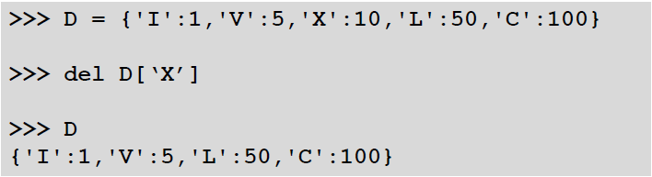
Deleting a dictionary element?
del command can be used to del an element of dictionary.
Example:
Notes:
Programming sekhny ka maksad hia k ham apni real life problem computer ki madad sy solve ker sakhain.
Ham apni roz mara zindagi main bhot sary decision conditions ki base per lyty hain jesy k
Agr kal barish hoi to ham pick nick per jain gy
Agr aaj school ki chuti hoi to main cartoon daikoun ga
Or Agr kal mjy job mill gi to main aap ko party doun ga.
In conditions ko programming main handel kerny k leay conditional structure use hoty hain.

Slide 17
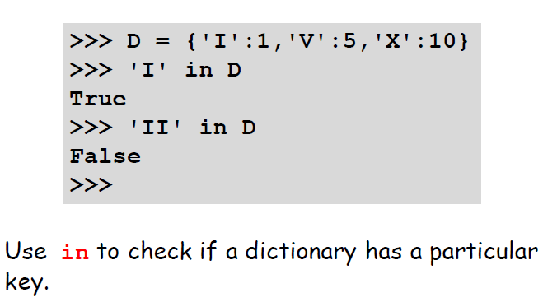
How to check if a dictionary has a p particular key?
Notes:
Programming sekhny ka maksad hia k ham apni real life problem computer ki madad sy solve ker sakhain.
Ham apni roz mara zindagi main bhot sary decision conditions ki base per lyty hain jesy k
Agr kal barish hoi to ham pick nick per jain gy
Agr aaj school ki chuti hoi to main cartoon daikoun ga
Or Agr kal mjy job mill gi to main aap ko party doun ga.
In conditions ko programming main handel kerny k leay conditional structure use hoty hain.

Slide 18
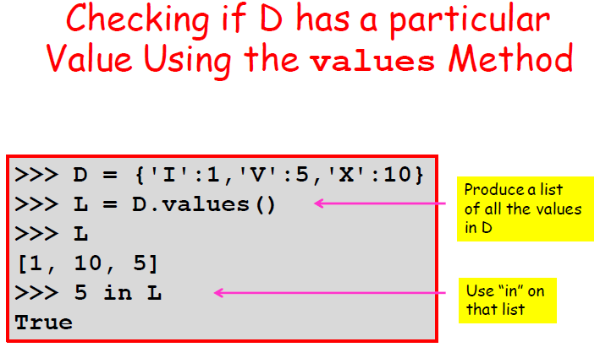
Operations on a dictionary?
Notes:
Programming sekhny ka maksad hia k ham apni real life problem computer ki madad sy solve ker sakhain.
Ham apni roz mara zindagi main bhot sary decision conditions ki base per lyty hain jesy k
Agr kal barish hoi to ham pick nick per jain gy
Agr aaj school ki chuti hoi to main cartoon daikoun ga
Or Agr kal mjy job mill gi to main aap ko party doun ga.
In conditions ko programming main handel kerny k leay conditional structure use hoty hain.

Slide 19
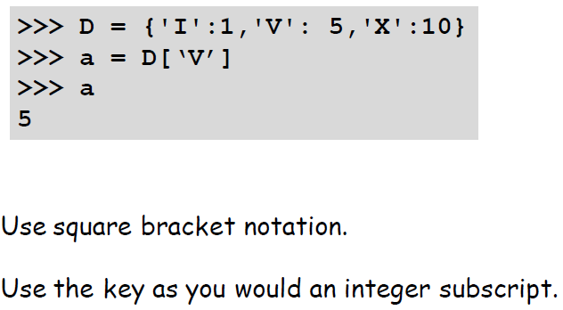
Extracting a value from dictionary?
Notes:
Programming sekhny ka maksad hia k ham apni real life problem computer ki madad sy solve ker sakhain.
Ham apni roz mara zindagi main bhot sary decision conditions ki base per lyty hain jesy k
Agr kal barish hoi to ham pick nick per jain gy
Agr aaj school ki chuti hoi to main cartoon daikoun ga
Or Agr kal mjy job mill gi to main aap ko party doun ga.
In conditions ko programming main handel kerny k leay conditional structure use hoty hain.

Slide 20
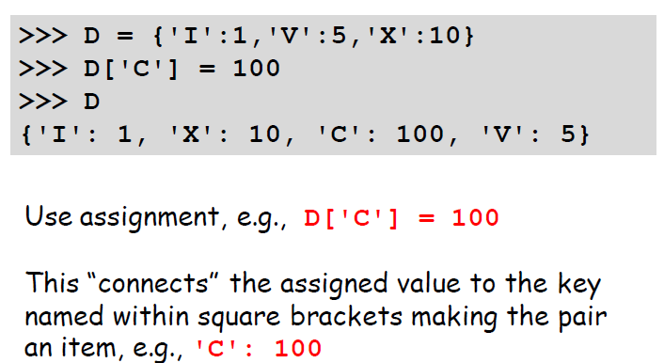
Add an item in a dictionary?
Notes:
Programming sekhny ka maksad hia k ham apni real life problem computer ki madad sy solve ker sakhain.
Ham apni roz mara zindagi main bhot sary decision conditions ki base per lyty hain jesy k
Agr kal barish hoi to ham pick nick per jain gy
Agr aaj school ki chuti hoi to main cartoon daikoun ga
Or Agr kal mjy job mill gi to main aap ko party doun ga.
In conditions ko programming main handel kerny k leay conditional structure use hoty hain.

Slide 21
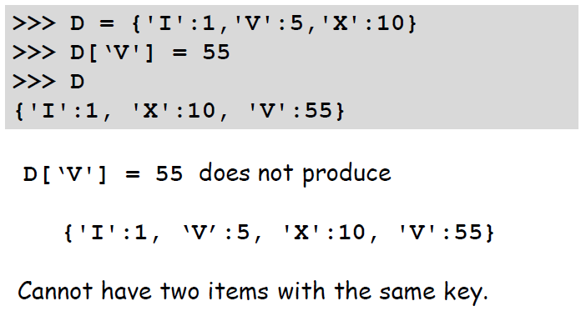
Changing a value in a dictionary?
Notes:
Programming sekhny ka maksad hia k ham apni real life problem computer ki madad sy solve ker sakhain.
Ham apni roz mara zindagi main bhot sary decision conditions ki base per lyty hain jesy k
Agr kal barish hoi to ham pick nick per jain gy
Agr aaj school ki chuti hoi to main cartoon daikoun ga
Or Agr kal mjy job mill gi to main aap ko party doun ga.
In conditions ko programming main handel kerny k leay conditional structure use hoty hain.

Slide 22
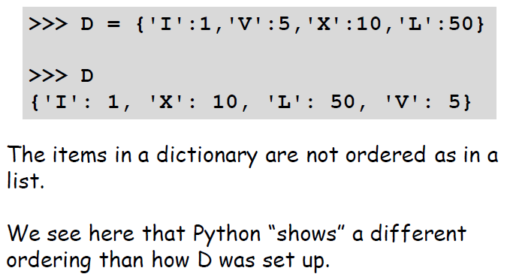
Dictionary is a different from list?
Notes:
Programming sekhny ka maksad hia k ham apni real life problem computer ki madad sy solve ker sakhain.
Ham apni roz mara zindagi main bhot sary decision conditions ki base per lyty hain jesy k
Agr kal barish hoi to ham pick nick per jain gy
Agr aaj school ki chuti hoi to main cartoon daikoun ga
Or Agr kal mjy job mill gi to main aap ko party doun ga.
In conditions ko programming main handel kerny k leay conditional structure use hoty hain.

Slide 23
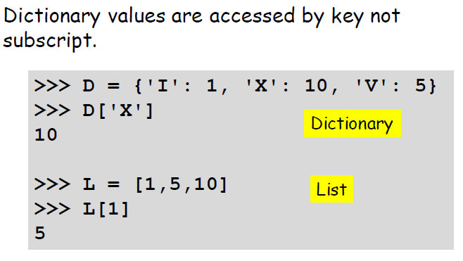
Dictionary is a different from list?
Notes:
Programming sekhny ka maksad hia k ham apni real life problem computer ki madad sy solve ker sakhain.
Ham apni roz mara zindagi main bhot sary decision conditions ki base per lyty hain jesy k
Agr kal barish hoi to ham pick nick per jain gy
Agr aaj school ki chuti hoi to main cartoon daikoun ga
Or Agr kal mjy job mill gi to main aap ko party doun ga.
In conditions ko programming main handel kerny k leay conditional structure use hoty hain.

Slide 24
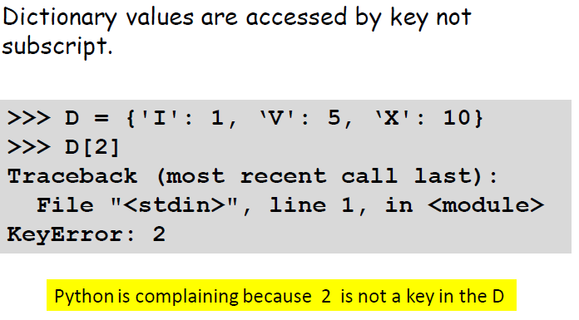
Dictionary is a different from list?
Notes:
Programming sekhny ka maksad hia k ham apni real life problem computer ki madad sy solve ker sakhain.
Ham apni roz mara zindagi main bhot sary decision conditions ki base per lyty hain jesy k
Agr kal barish hoi to ham pick nick per jain gy
Agr aaj school ki chuti hoi to main cartoon daikoun ga
Or Agr kal mjy job mill gi to main aap ko party doun ga.
In conditions ko programming main handel kerny k leay conditional structure use hoty hain.

Slide 25
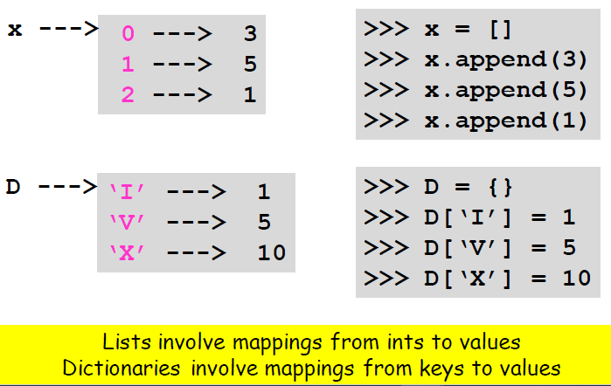
Dictionary is a different from list?
Notes:
Programming sekhny ka maksad hia k ham apni real life problem computer ki madad sy solve ker sakhain.
Ham apni roz mara zindagi main bhot sary decision conditions ki base per lyty hain jesy k
Agr kal barish hoi to ham pick nick per jain gy
Agr aaj school ki chuti hoi to main cartoon daikoun ga
Or Agr kal mjy job mill gi to main aap ko party doun ga.
In conditions ko programming main handel kerny k leay conditional structure use hoty hain.

Slide 26
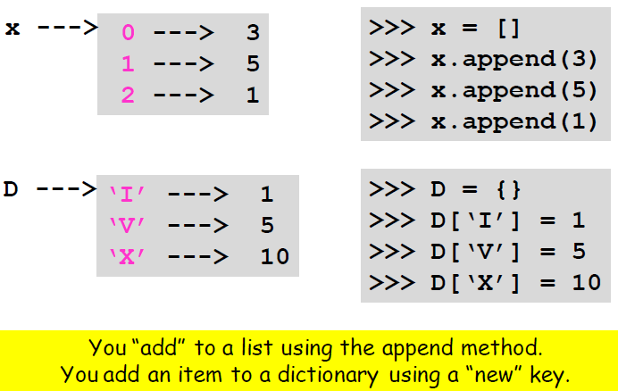
Dictionary is a different from list?
Notes:
Programming sekhny ka maksad hia k ham apni real life problem computer ki madad sy solve ker sakhain.
Ham apni roz mara zindagi main bhot sary decision conditions ki base per lyty hain jesy k
Agr kal barish hoi to ham pick nick per jain gy
Agr aaj school ki chuti hoi to main cartoon daikoun ga
Or Agr kal mjy job mill gi to main aap ko party doun ga.
In conditions ko programming main handel kerny k leay conditional structure use hoty hain.

Slide 27
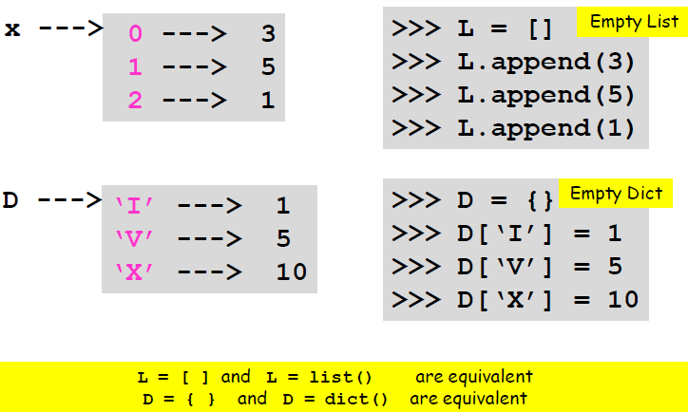
Dictionary is a different from list?
Notes:
Programming sekhny ka maksad hia k ham apni real life problem computer ki madad sy solve ker sakhain.
Ham apni roz mara zindagi main bhot sary decision conditions ki base per lyty hain jesy k
Agr kal barish hoi to ham pick nick per jain gy
Agr aaj school ki chuti hoi to main cartoon daikoun ga
Or Agr kal mjy job mill gi to main aap ko party doun ga.
In conditions ko programming main handel kerny k leay conditional structure use hoty hain.

Slide 28
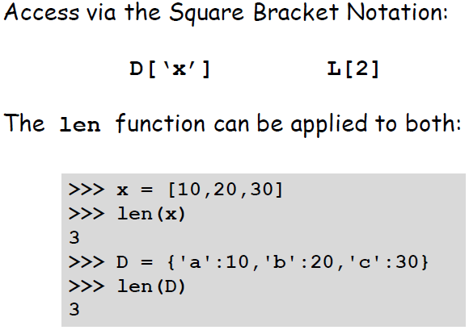
Dictionary is a different from list?
Notes:
Programming sekhny ka maksad hia k ham apni real life problem computer ki madad sy solve ker sakhain.
Ham apni roz mara zindagi main bhot sary decision conditions ki base per lyty hain jesy k
Agr kal barish hoi to ham pick nick per jain gy
Agr aaj school ki chuti hoi to main cartoon daikoun ga
Or Agr kal mjy job mill gi to main aap ko party doun ga.
In conditions ko programming main handel kerny k leay conditional structure use hoty hain.

Slide 29
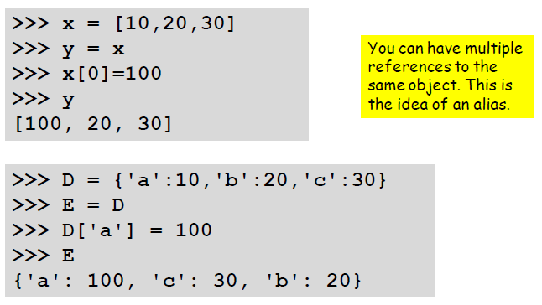
Dictionary is a different from list?
Notes:
Programming sekhny ka maksad hia k ham apni real life problem computer ki madad sy solve ker sakhain.
Ham apni roz mara zindagi main bhot sary decision conditions ki base per lyty hain jesy k
Agr kal barish hoi to ham pick nick per jain gy
Agr aaj school ki chuti hoi to main cartoon daikoun ga
Or Agr kal mjy job mill gi to main aap ko party doun ga.
In conditions ko programming main handel kerny k leay conditional structure use hoty hain.

Slide 30
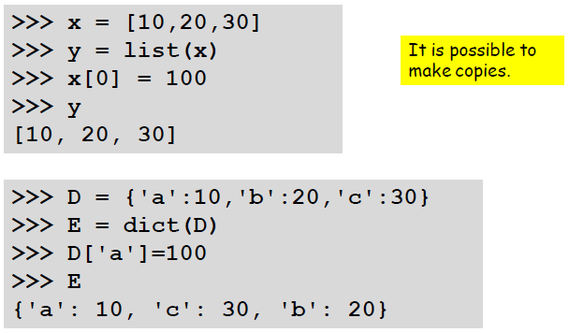
Dictionary is a different from list?
Notes:
Programming sekhny ka maksad hia k ham apni real life problem computer ki madad sy solve ker sakhain.
Ham apni roz mara zindagi main bhot sary decision conditions ki base per lyty hain jesy k
Agr kal barish hoi to ham pick nick per jain gy
Agr aaj school ki chuti hoi to main cartoon daikoun ga
Or Agr kal mjy job mill gi to main aap ko party doun ga.
In conditions ko programming main handel kerny k leay conditional structure use hoty hain.

Slide 31
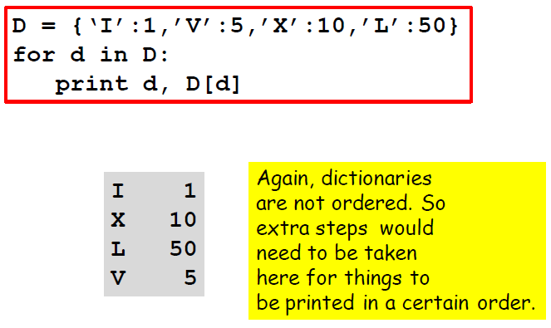
Iterating through a dictionary?
Notes:
Programming sekhny ka maksad hia k ham apni real life problem computer ki madad sy solve ker sakhain.
Ham apni roz mara zindagi main bhot sary decision conditions ki base per lyty hain jesy k
Agr kal barish hoi to ham pick nick per jain gy
Agr aaj school ki chuti hoi to main cartoon daikoun ga
Or Agr kal mjy job mill gi to main aap ko party doun ga.
In conditions ko programming main handel kerny k leay conditional structure use hoty hain.

Slide 32
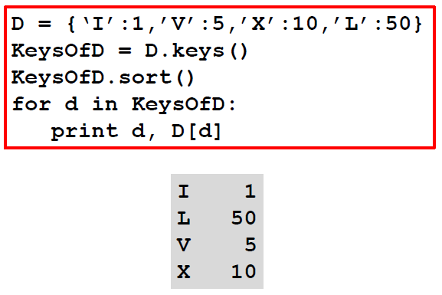
Iterating through a dictionary?
Keys of dictionary can be sorted using sort() function.
Notes:
Programming sekhny ka maksad hia k ham apni real life problem computer ki madad sy solve ker sakhain.
Ham apni roz mara zindagi main bhot sary decision conditions ki base per lyty hain jesy k
Agr kal barish hoi to ham pick nick per jain gy
Agr aaj school ki chuti hoi to main cartoon daikoun ga
Or Agr kal mjy job mill gi to main aap ko party doun ga.
In conditions ko programming main handel kerny k leay conditional structure use hoty hain.

Slide 33
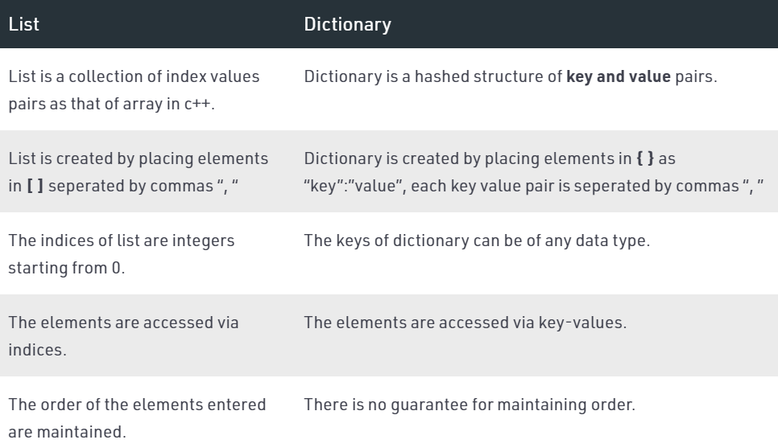
Dictionary is a different from list?
Notes:
Programming sekhny ka maksad hia k ham apni real life problem computer ki madad sy solve ker sakhain.
Ham apni roz mara zindagi main bhot sary decision conditions ki base per lyty hain jesy k
Agr kal barish hoi to ham pick nick per jain gy
Agr aaj school ki chuti hoi to main cartoon daikoun ga
Or Agr kal mjy job mill gi to main aap ko party doun ga.
In conditions ko programming main handel kerny k leay conditional structure use hoty hain.

Slide 34
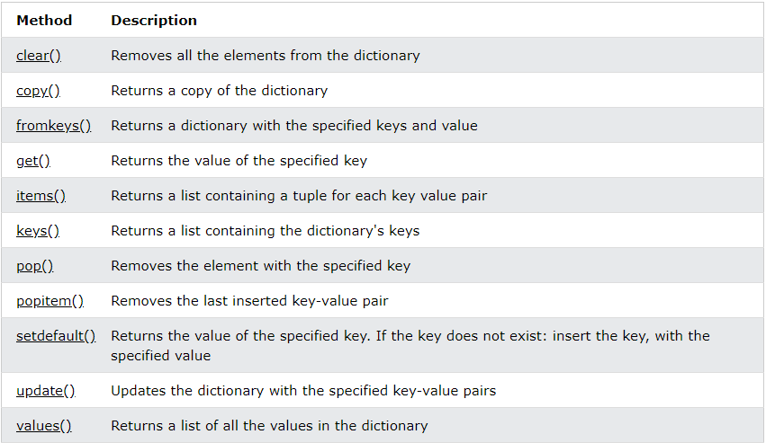
Dictionary Methods?
Notes:
Programming sekhny ka maksad hia k ham apni real life problem computer ki madad sy solve ker sakhain.
Ham apni roz mara zindagi main bhot sary decision conditions ki base per lyty hain jesy k
Agr kal barish hoi to ham pick nick per jain gy
Agr aaj school ki chuti hoi to main cartoon daikoun ga
Or Agr kal mjy job mill gi to main aap ko party doun ga.
In conditions ko programming main handel kerny k leay conditional structure use hoty hain.

Slide 35
Set in Python

Slide 36
Why do we need set in Python?
Set is one of 4 built-in data types in Python used to store collections of data, the other 3 are List, Tuple, and Dictionary, all with different qualities and usage.
Notes:
Programming sekhny ka maksad hia k ham apni real life problem computer ki madad sy solve ker sakhain.
Ham apni roz mara zindagi main bhot sary decision conditions ki base per lyty hain jesy k
Agr kal barish hoi to ham pick nick per jain gy
Agr aaj school ki chuti hoi to main cartoon daikoun ga
Or Agr kal mjy job mill gi to main aap ko party doun ga.
In conditions ko programming main handel kerny k leay conditional structure use hoty hain.

Slide 37
What is a set in Python?
A set is a collection which is unordered, unchangeable, and unindexed.
Set don’t allow duplicate values.
Set items can be of any data type.
Notes:
Programming sekhny ka maksad hia k ham apni real life problem computer ki madad sy solve ker sakhain.
Ham apni roz mara zindagi main bhot sary decision conditions ki base per lyty hain jesy k
Agr kal barish hoi to ham pick nick per jain gy
Agr aaj school ki chuti hoi to main cartoon daikoun ga
Or Agr kal mjy job mill gi to main aap ko party doun ga.
In conditions ko programming main handel kerny k leay conditional structure use hoty hain.

Slide 38
How set is different from dictionary?
For a dictionary, hash tables store three elements: hash, key, and value.
For a set, the difference is that there is no key-value pairing in the hash table, only a single element.
Notes:
Programming sekhny ka maksad hia k ham apni real life problem computer ki madad sy solve ker sakhain.
Ham apni roz mara zindagi main bhot sary decision conditions ki base per lyty hain jesy k
Agr kal barish hoi to ham pick nick per jain gy
Agr aaj school ki chuti hoi to main cartoon daikoun ga
Or Agr kal mjy job mill gi to main aap ko party doun ga.
In conditions ko programming main handel kerny k leay conditional structure use hoty hain.

Slide 39
Creating a set in Python?
Sets are written in curly brackets {}.
Example:
thisset = {"apple", "banana", "cherry"} print(thisset)
Output: {‘apple’, ‘banana’, ‘cherry’}

Slide 40
Creating a set in Python?
It is also possible to use the set() constructor to make a set.
Example:
thisset = set(("apple", "banana", "cherry")) print(thisset)
Output: {‘apple’, ‘banana’, ‘cherry’}

Slide 41
Accessing item from a set?
You cannot access items in a set by referring to an index or a key. But you can loop through the set items using a for loop, or ask if a specified value is present in a set, by using the in keyword.
Example:
thisset = {"apple", "banana", "cherry"} for x in thisset: print(x)
Output: apple
banana
cherry
Notes:
Programming sekhny ka maksad hia k ham apni real life problem computer ki madad sy solve ker sakhain.
Ham apni roz mara zindagi main bhot sary decision conditions ki base per lyty hain jesy k
Agr kal barish hoi to ham pick nick per jain gy
Agr aaj school ki chuti hoi to main cartoon daikoun ga
Or Agr kal mjy job mill gi to main aap ko party doun ga.
In conditions ko programming main handel kerny k leay conditional structure use hoty hain.

Slide 42
Accessing item from a set?
Use in keyword to check if specific element is present in the set or not.
Example:
thisset = {"apple", "banana", "cherry"} print("banana" in thisset)
Output: True
Notes:
Programming sekhny ka maksad hia k ham apni real life problem computer ki madad sy solve ker sakhain.
Ham apni roz mara zindagi main bhot sary decision conditions ki base per lyty hain jesy k
Agr kal barish hoi to ham pick nick per jain gy
Agr aaj school ki chuti hoi to main cartoon daikoun ga
Or Agr kal mjy job mill gi to main aap ko party doun ga.
In conditions ko programming main handel kerny k leay conditional structure use hoty hain.

Slide 43
How to update a set?
Once a set is created, you cannot change its items, but you can add new items
Notes:
Programming sekhny ka maksad hia k ham apni real life problem computer ki madad sy solve ker sakhain.
Ham apni roz mara zindagi main bhot sary decision conditions ki base per lyty hain jesy k
Agr kal barish hoi to ham pick nick per jain gy
Agr aaj school ki chuti hoi to main cartoon daikoun ga
Or Agr kal mjy job mill gi to main aap ko party doun ga.
In conditions ko programming main handel kerny k leay conditional structure use hoty hain.

Slide 44
How to add an item in a set?
To add one item to a set use the add() method.
Example:
thisset = {"apple", "banana", "cherry"} thisset.add("orange") print(thisset)
Output: {"apple", “banana", “orange“,”cherry”}
Notes:
Programming sekhny ka maksad hia k ham apni real life problem computer ki madad sy solve ker sakhain.
Ham apni roz mara zindagi main bhot sary decision conditions ki base per lyty hain jesy k
Agr kal barish hoi to ham pick nick per jain gy
Agr aaj school ki chuti hoi to main cartoon daikoun ga
Or Agr kal mjy job mill gi to main aap ko party doun ga.
In conditions ko programming main handel kerny k leay conditional structure use hoty hain.

Slide 45
How to add an item in a set?
To add items from another set into the current set, use the update() method.
Example:
thisset = {"apple", "banana", "cherry"} tropical = {"pineapple", "mango", "papaya"} thisset.update(tropical) print(thisset)
Output: {'apple', 'mango', 'cherry', 'pineapple', 'banana', 'papaya'}
Notes:
Programming sekhny ka maksad hia k ham apni real life problem computer ki madad sy solve ker sakhain.
Ham apni roz mara zindagi main bhot sary decision conditions ki base per lyty hain jesy k
Agr kal barish hoi to ham pick nick per jain gy
Agr aaj school ki chuti hoi to main cartoon daikoun ga
Or Agr kal mjy job mill gi to main aap ko party doun ga.
In conditions ko programming main handel kerny k leay conditional structure use hoty hain.

Slide 46
How to remove an item in a set?
To remove an item in a set, use the remove(), or the discard() method.
If the item to remove does not exist, remove() will raise an error
Example:
thisset = {"apple", "banana", "cherry"}
thisset.remove("banana")
print(thisset)
Output: {‘apple’, ’cherry’}
Notes:
Programming sekhny ka maksad hia k ham apni real life problem computer ki madad sy solve ker sakhain.
Ham apni roz mara zindagi main bhot sary decision conditions ki base per lyty hain jesy k
Agr kal barish hoi to ham pick nick per jain gy
Agr aaj school ki chuti hoi to main cartoon daikoun ga
Or Agr kal mjy job mill gi to main aap ko party doun ga.
In conditions ko programming main handel kerny k leay conditional structure use hoty hain.

Slide 47
How to remove an item in a set?
To remove an item in a set by using the discard() method.
If the item to remove does not exist, discard() will not raise an error.
Example:
thisset = {"apple", "banana", "cherry"}
thisset.discard("banana")
print(thisset)
Output: {‘apple’, ’cherry’}
Notes:
Programming sekhny ka maksad hia k ham apni real life problem computer ki madad sy solve ker sakhain.
Ham apni roz mara zindagi main bhot sary decision conditions ki base per lyty hain jesy k
Agr kal barish hoi to ham pick nick per jain gy
Agr aaj school ki chuti hoi to main cartoon daikoun ga
Or Agr kal mjy job mill gi to main aap ko party doun ga.
In conditions ko programming main handel kerny k leay conditional structure use hoty hain.

Slide 48
How to remove an item in a set?
You can also use the pop() method to remove an item, but this method will remove the last item.
Remember that sets are unordered, so you will not know what item that gets removed.
Example:
thisset = {"apple", "banana", "cherry"}
x = thisset.pop()
print(x)
print(thisset)
Output: apple
Output: {‘cherry’, ’banana’}
Notes:
Programming sekhny ka maksad hia k ham apni real life problem computer ki madad sy solve ker sakhain.
Ham apni roz mara zindagi main bhot sary decision conditions ki base per lyty hain jesy k
Agr kal barish hoi to ham pick nick per jain gy
Agr aaj school ki chuti hoi to main cartoon daikoun ga
Or Agr kal mjy job mill gi to main aap ko party doun ga.
In conditions ko programming main handel kerny k leay conditional structure use hoty hain.

Slide 49
How to join two sets?
You can use the union() method that returns a new set containing all items from both sets
Example:
set1 = {"a", "b" , "c"}
set2 = {1, 2, 3}
set3 = set1.union(set2)
print(set3)
Output: {'b', 3, 'c', 'a', 1, 2}
Notes:
Programming sekhny ka maksad hia k ham apni real life problem computer ki madad sy solve ker sakhain.
Ham apni roz mara zindagi main bhot sary decision conditions ki base per lyty hain jesy k
Agr kal barish hoi to ham pick nick per jain gy
Agr aaj school ki chuti hoi to main cartoon daikoun ga
Or Agr kal mjy job mill gi to main aap ko party doun ga.
In conditions ko programming main handel kerny k leay conditional structure use hoty hain.

Slide 50
How to join two sets?
The update() method that inserts all the items from one set into another.
Both union() and update() will exclude any duplicate items.
Example:
set1 = {"a", "b" , "c"}
set2 = {1, 2, 3}
set1.update(set2)
print(set1)
Output: {'b', 2, 'c', 'a', 1, 3}
Notes:
Programming sekhny ka maksad hia k ham apni real life problem computer ki madad sy solve ker sakhain.
Ham apni roz mara zindagi main bhot sary decision conditions ki base per lyty hain jesy k
Agr kal barish hoi to ham pick nick per jain gy
Agr aaj school ki chuti hoi to main cartoon daikoun ga
Or Agr kal mjy job mill gi to main aap ko party doun ga.
In conditions ko programming main handel kerny k leay conditional structure use hoty hain.

Slide 51
How to join two sets?
The intersection_update() method will keep only the items that are present in both sets.
Example:
x = {"apple", "banana", "cherry"}
y = {"google", "microsoft", "apple"}
x.intersection_update(y)
print(x)
Output: {‘apple'}
Notes:
Programming sekhny ka maksad hia k ham apni real life problem computer ki madad sy solve ker sakhain.
Ham apni roz mara zindagi main bhot sary decision conditions ki base per lyty hain jesy k
Agr kal barish hoi to ham pick nick per jain gy
Agr aaj school ki chuti hoi to main cartoon daikoun ga
Or Agr kal mjy job mill gi to main aap ko party doun ga.
In conditions ko programming main handel kerny k leay conditional structure use hoty hain.

Slide 52
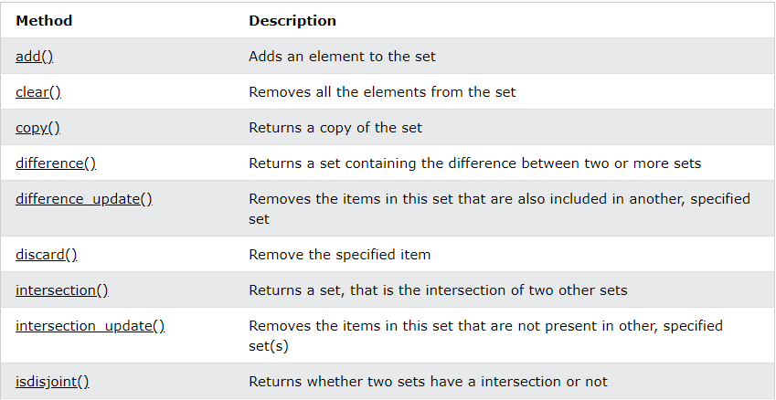
Set methods?
Python has built-in methods that you can use on t
Notes:
Programming sekhny ka maksad hia k ham apni real life problem computer ki madad sy solve ker sakhain.
Ham apni roz mara zindagi main bhot sary decision conditions ki base per lyty hain jesy k
Agr kal barish hoi to ham pick nick per jain gy
Agr aaj school ki chuti hoi to main cartoon daikoun ga
Or Agr kal mjy job mill gi to main aap ko party doun ga.
In conditions ko programming main handel kerny k leay conditional structure use hoty hain.

Slide 53
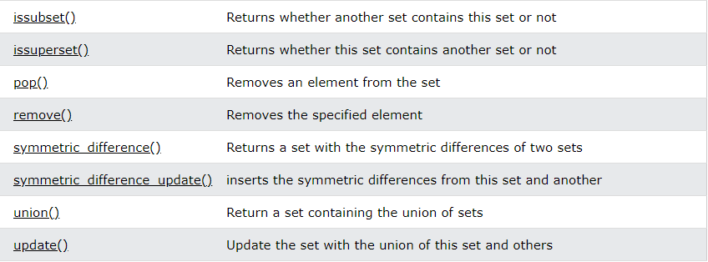
Set methods?
Python has built-in methods that you can use on t
Notes:
Programming sekhny ka maksad hia k ham apni real life problem computer ki madad sy solve ker sakhain.
Ham apni roz mara zindagi main bhot sary decision conditions ki base per lyty hain jesy k
Agr kal barish hoi to ham pick nick per jain gy
Agr aaj school ki chuti hoi to main cartoon daikoun ga
Or Agr kal mjy job mill gi to main aap ko party doun ga.
In conditions ko programming main handel kerny k leay conditional structure use hoty hain.

Slide 54

Learning Objective
In this lecture, we learnt what is a dictionary and set, why we need dictionary and set, how to create and write a dictionary and list in Python and which operations we can perform on dictionary and list.
Notes:
After this lecture, you shall be able to Explain why we need variables and what is their relation to the memory.

Slide 55

Conclusion
To store multiple data in programming, list is used.
With the help of dictionary and set methods we can perform many operations on dictionary and set.
Built-In functins can also be used on dictionary and set.
Notes:
Programming main decision making achieve kerny k leay conditional structure use hoty hain, comparision operator jisy ham double equal operator bhe bolyt hian 2 values ko compare kerny k leay use hota hia.
Is k elawa if command main likhe jany wali condition ko ham Boolean expression bhe khety hain.

Slide 56

Self Assessment
Solve the Following Programs
Write a program to use the get method to print the value of the "model" key of the car dictionary.
car = { "brand": "Ford", "model": "Mustang", "year": 1964 }
2. Write a program to change the “year” value from 1964 to 2021.
3. Write a program to add key/value pair “color”:red in a car dictionary.
4. Write a program to use the pop method to remove "model" from the car dictionary

Slide 57
Self Assessment
Solve Following Programs
Write a Program that takes two dictionaries and returns true if they have at least one common element.

Slide 58
Self Assessment
Solve Following Programs
Write a program to check if “apple” is present in fruits set or not.
fruits = {“apple”,”banana”,”cherry”}
2. Write a program to add “orange” to the fruits set given above.
3. Write a program to remove “banana” from a fruits set.

